Slide 1
LG 42SL90QD
Skyforce / RSEE4
2009/12/07

Slide 2
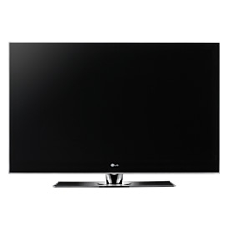
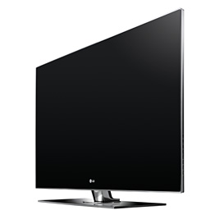
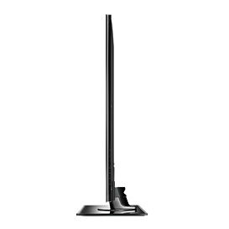
Basic Spec (1/2)
LCD規格
解析度 | 1920*1080
亮度 (cd/m²) | 500
液晶面板 | IPS面板
動態對比 | 3,000,000:1
色彩 (R,G,B) | 10bit
自動影像控制 | 9 modes(智慧感應/明亮/標準/自然/劇院/運動/遊戲/專業模式1/專業模式2)

Slide 3
Basic Spec (2/2)
模式/功能 | Vivid | Standard | Natural | Cinema | Sport | Game | Expert | 附註
Backlight | 100 | 70 | 90 | 30 | 100 | 60 | 30
Contrast | 100 | 90 | 90 | 90 | 90 | 90 | 90
Brightness | 50 | 50 | 50 | 50 | 50 | 50 | 50
Sharpness | 70 | 70 | 60 | 50 | 70 | 55 | *²
H Sharpness | *² | *² | *² | *² | *² | *² | 50
V Sharpness | *² | *² | *² | *² | *² | *² | 50
Color | 70 | 60 | 60 | 50 | 60 | 55 | 50
Tint | 0 | 0 | 0 | 0 | 0 | 0 | 0
Color Temperature | Cool | Medium | Medium | Warm | Medium | Medium | Warm
Dynamic Contrast*³ | High | Medium | Low | Off | High | Off | Off | 動態對比
Dynamic Color*³ | High | Low | Off | Off | High | Off | *² | 動態色彩
Noise Reduction*³ | Medium | Medium | Medium | Off | Medium | Off | Off
Gamma | Medium | Medium | Medium | Medium | Medium | Medium | Medium
Black Level | Low | Low | Low | Low | Low | Low | Low
Eye Care*³ | Off*¹ | Off | On | Off*¹ | On | Off | *² | 亮度抑制
Real Cinema | On | On | On | On | On | On | On | 真實24 fps
TruMotion 120Hz*³ | Low | Low | Low | Low | Low | Off | Low | ME/MC
Color Standard | *² | *² | *² | *² | *² | *² | HD*¹
Color Gamut | Wide | Wide | Wide | Standard | Wide | Wide | Standard
Edge Enhancer | Off*¹ | Off*¹ | Off*¹ | High | Off*¹ | Off*¹ | High
OPC*³ | On | On | On | Off | On | On | Off | 動態背光
*¹選項反白不可選
*²選項消失
*³進行色彩量測時，此選項關閉(Off)

Slide 4
Analysis Item
不同情境模式下的色彩調整方式
  Contrast
  Color Gamut
  Color Temperature
  Gamma Curve
標準模式下sRGB Spec
無DCC (Dynamic Contrast Control) 功能，因此無DCC特性分析

Slide 5
Measurement
 | Vivid | Standard | Natural | Cinema | Sport | Game
Max Lum @ W255 | 465.23 | 465.03 | 381.05 | 139.08 | 412.72 | 268.86
Min Lum @ W0 | 0.31 | 0.31 | 0.29 | 0.11 | 0.30 | 0.20
Contrast Ratio | 1502 | 1484 | 1328 | 1211 | 1357 | 1325
Color Temperature | 9663 | 9818 | 8804 | 6211 | 8465 | 8680
Δuv | 0.0068 | 0.0064 | 0.0015 | 0.0052 | 0.0019 | 0.0018
NTSC @ xy | 81% | 81% | 81% | 81% | 81% | 82%
NTSC @ u'v' | 94% | 94% | 94% | 94% | 94% | 94%
TCO'03 Δu'v' | 0.0061 | 0.0060 | 0.0059 | 0.0037 | 0.0053 | 0.0062

Slide 6
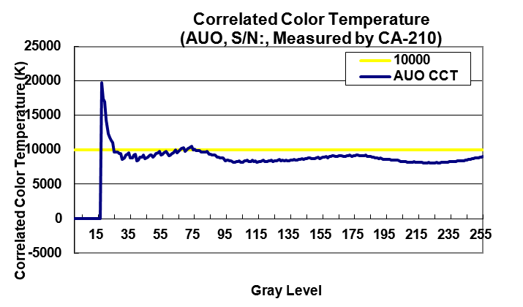
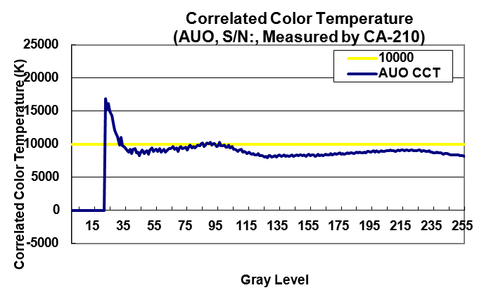
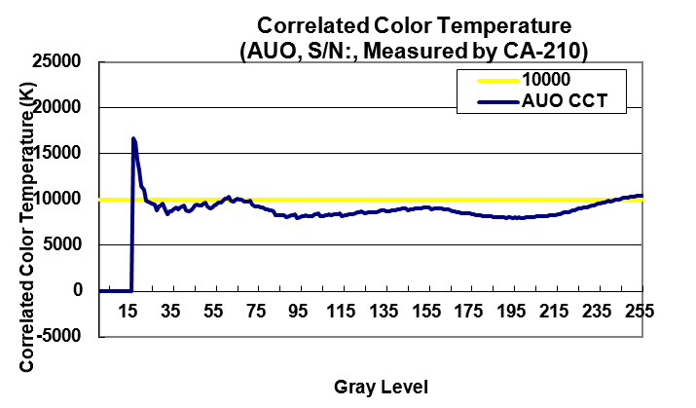
Color temperature
標準
柔和
明亮
50以上色溫變化約±1000k
三種模式下的中低灰階的色溫變化大致相近，高灰階差異較大

Slide 7
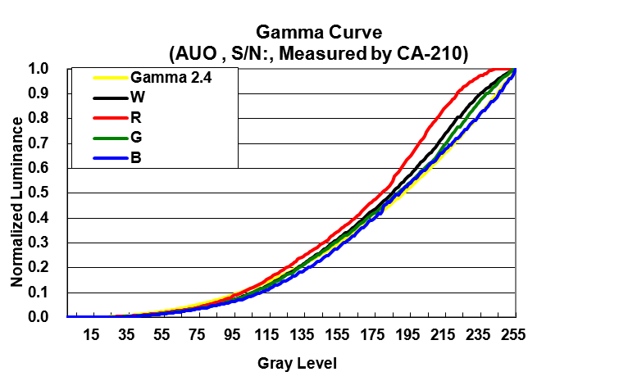
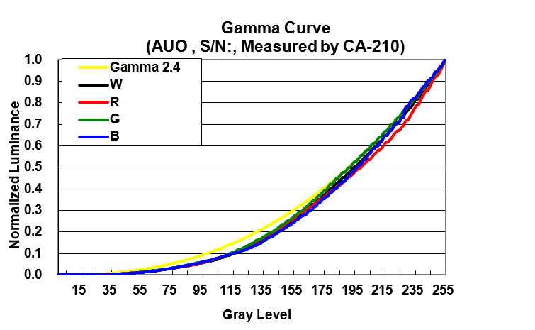
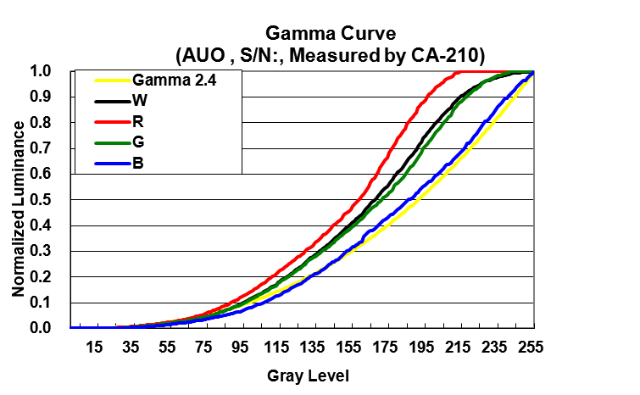
Gamma Curve
標準
柔和
Clip!
明亮
B在柔和模式下有較為明顯的調整；三種模式下R/G調整幅度較大
明亮及標準模式下，R有明顯clip現象
Gamma皆呈現S-Curve現象
Clip!

Slide 8
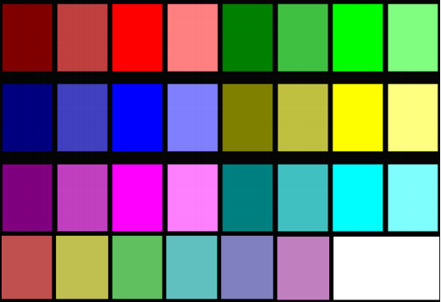
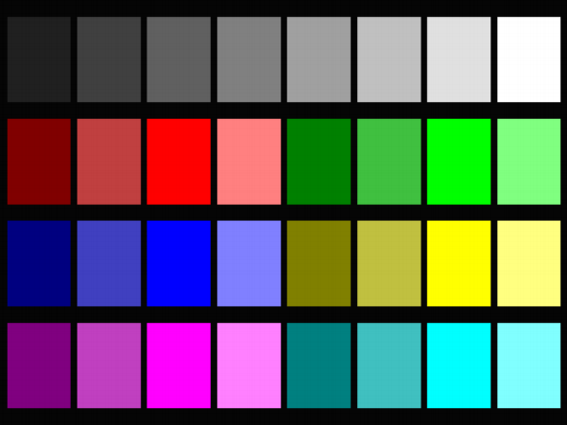
sRGB Spec (標準)
IEC61966-4 32 Patch
Stand Along 7 Patch
Stand Alone 7 Patch | Average Delta E* | 2.96
 | Maximum Delta E* | 4.5
IEC61966-4 32 Patch | Average Delta E* | 3.3

Slide 9
Summary
三種mode在色溫變化上無太大差異(8200~10400k)，主要在於亮度的改變。
調整的方式由於以下特性，其結果不盡理想：
  Gamma接近LCD原始特性(S-Curve)，而非特定Gamma指數曲線，Gamma可能無特別調整。
  明亮及標準模式下，R有明顯clip現象，造成階調損失。

